Slide 1
A cluster-randomised controlled trial, implementing CONn Syndrome screening and Evaluation in Primary care (CONSEP)
Local presenter information

Slide 2
What is CONSEP?
CONSEP aims to increase screening and diagnosis of primary aldosteronism in people living with hypertension who attend general practice.
Intervention Arm
Screening facilitated with a clinical decision support tool (Guideline-Based Requesting - GBR) integrated into Best Practice.
Control Arm
Screening using standard pathology requesting in Best Practice.
Notes:
Lit review from 1955 to now
Stakeholders included chemical pathologists, radiologist, surgeons, GPs and of course endocrinologists
Experts include key members of the Endocrine Society Practice Guidelines panel, Prof Funder and Prof Stowasser in Australia

Slide 3
CONSEP- Study Design
Intervention Arm
Control Arm
Best Practice data extraction
Introduction to CONSEP trial and PA screening (20 -30 min)
GBR switch on
GBR user education (10 -20 min)
Best Practice data extraction
Introduction to CONSEP trial and PA screening (20 -30 min)
Month 0
Month 3
ARR order and GBR audit
ARR order audit
Month 12
Best Practice data extraction
Practice interview (30 min)
Best Practice data extraction
Month 24
Best Practice data extraction
Best Practice data extraction

Slide 4
What to do as a participating GP
Who to screen:
Minimum x 2 readings of BP ≥ 140/90 (systolic blood pressure ≥ 140 or diastolic blood pressure ≥90)
OR ≥ 4 BP-lowering drugs
Who to refer:
ARR ≥ 70 + not on interfering medications - refer to [local Endocrine hypertension service]
ARR ≥ 20 + on interfering medications - refer to [local Endocrine hypertension service]
ARR < 70, not on interfering meds, or on interfering meds + ARR < 20 - manage at general practice
Patient referred back from Endocrinologist: record their diagnosis in Best Practice and keep managing at general practice

Slide 5
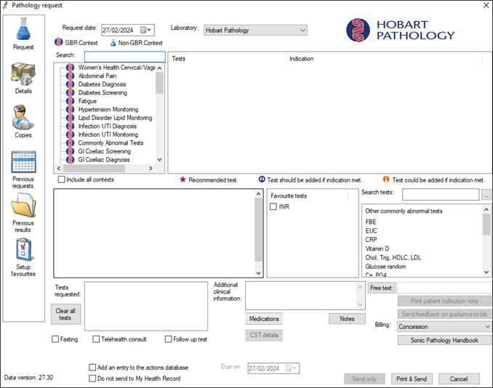
Ordering ARR – Intervention Arm
Pathology ordering with GBR
Select clinical contexts ‘hypertension (diagnosis)’ or ‘hypertension (monitoring)’
Tick ‘renin, aldosterone’
Can add additional tests
Print and send
Local Sonic Pathology Requirements
Hobart
Before 10am, gladstone practice only.
Melbourne
Doctor/clinic collections: send the unspun samples at ambient temperature in a red "urgent" bag with the next courier.
Adelaide
Booking required, can only be performed at specific collection centres (TBA)

Slide 6
Thank you! Questions?

